Slide 1
Ecco Restaurant Marketing Analysis
Kaushik Suresh

Slide 2
Ecco Restaurant
Ecco is an upscale Italian Restaurant with traditional homestyle cooking
After a lot of thought and hard work the Ecco management have given a thought to restart their business in the same exact location where they have been serving their authentic dishes for the past three decades.
In order to let people know that they are back in business, they have strategized a marketing plan to distribute pamphlet posters of their 50% offer from Dec 14th to Dec 27th, 2021 for any orders above 20$.

Slide 3
GOAL
To identify the most prominent places near their neighbourhood to distribute these issued pamphlets to make sure that they attain high profits and brand reachability.

Slide 4
DATA
The data required for the task has been acquired using the FouresquareAPI, which gives us the details like Latitude, Longitude, Ratings, Demographic details of the popular around Eeco restaurant
Using the FourSqaureAPI all the prominent places around Eeco restaurant in the radius of 1000 metre
The data was converted into a data frame and the handling of missing values and removing the comma(,) values were done on the dataset. The final dataset had around 30 popular location near to Eeco restaurant.

Slide 5
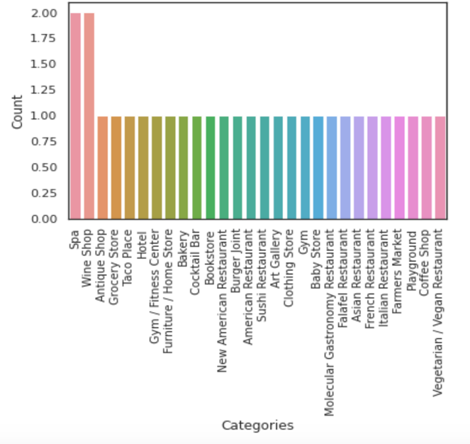
Frequency of the categories
Spa and wine shops have the highest frequency

Slide 6
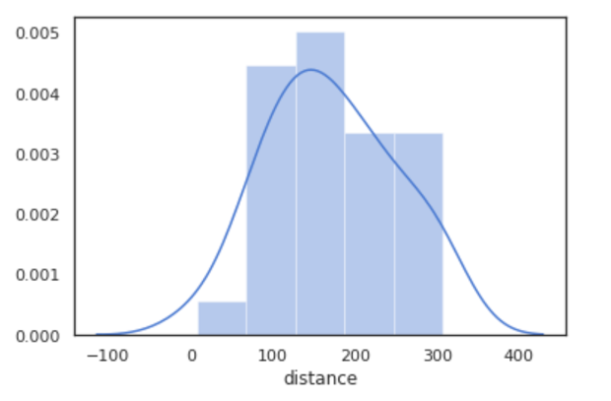
30 prominent places near the restaurant were with 300 metres of distance, where 150 metres being the highest distance from Eeco
Distribution of the distance between the popular places and Eeco

Slide 7
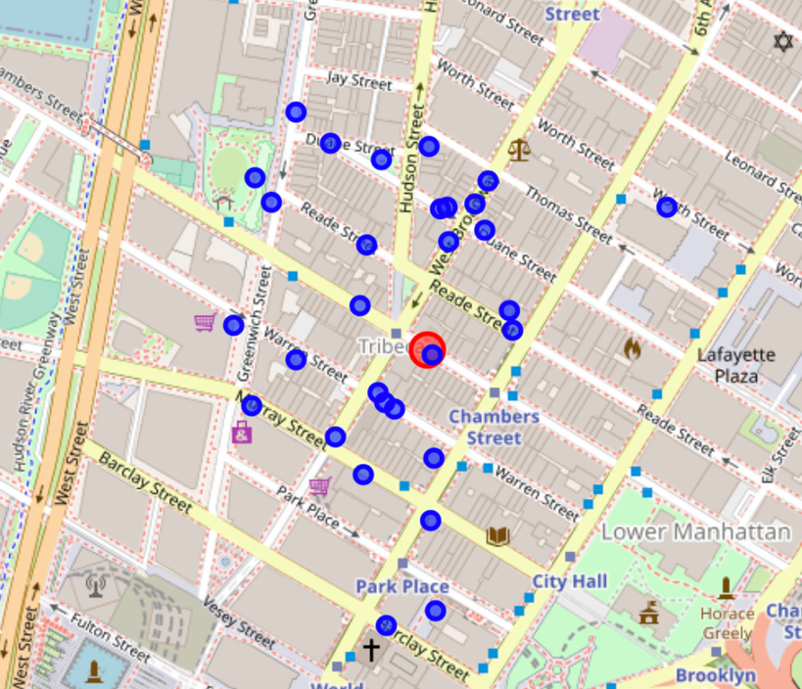
Geo-spatial visualization of popular locations
Folium maps were used to visualize the 30 popular places near Eeco
The Red dot in the below image denotes the Eeco and the blue dots represent the prominent places near Eeco. This gives us a wider visual representation of the how close these locations are to Eeco.

Slide 8
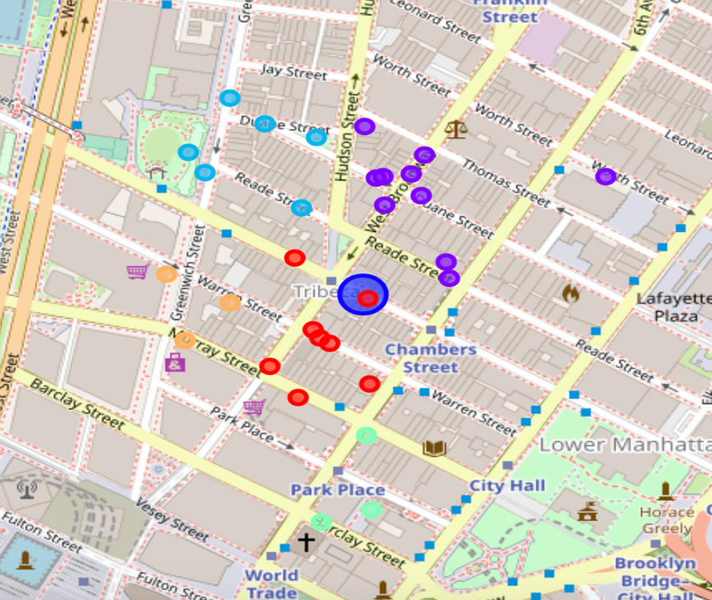
KNN clustering
A KNN clustering was performed among their 30 locations with a k values of 5 forming 5 different clusters based on their latitude and longitude locations

Slide 9
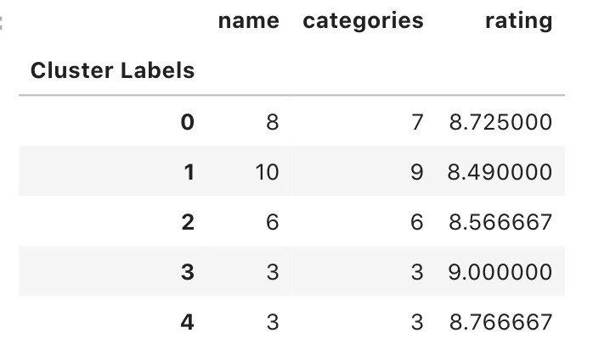
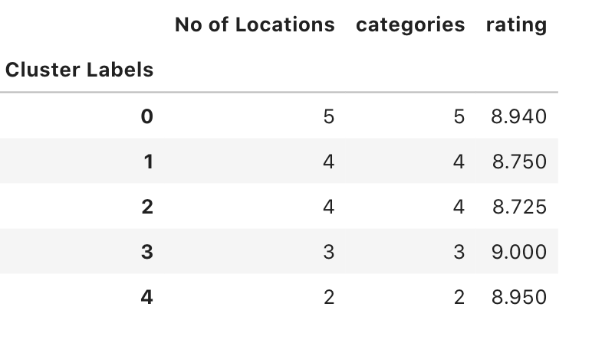
For each of the 30 locations, a threshold value was set at 8.5, only locations with rating greater than 8.5 were considered into analysis. After the removal of the locations which didn’t meet the criteria, the number of locations were narrowed down to 18 from 30
Before thresholding
After thresholding

Slide 10
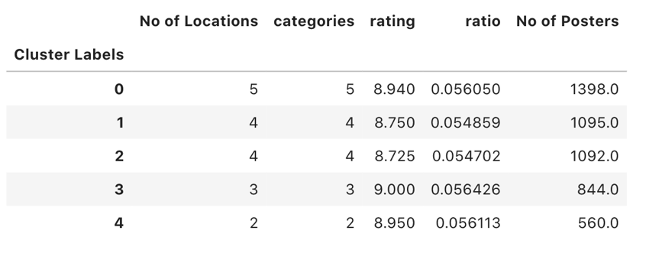
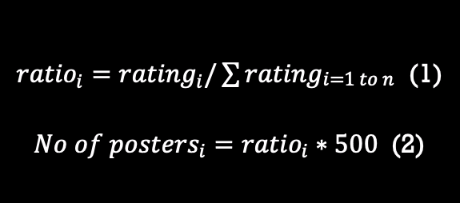
Ratio and No of posters calculation
${ratio}_{i}={rating}_{i}/\sum{{rating}_{\begin{aligned}i=1 to n \\ \end{aligned}}}$ (1)
${No of posters}_{i}={ratio}_{i}∗500$ (2)
Based on the ratings the ratio for each cluster i(0 to n) was calculated as shown in Eq. 1.
Since the allotted money for the marketing strategy was 10000$ and each pamphlet costs around 2$,
the number of pamphlets available is 500.
The number of pamphlets allotted to each cluster is calculated using the formula shown in Eq. 2.

Slide 11
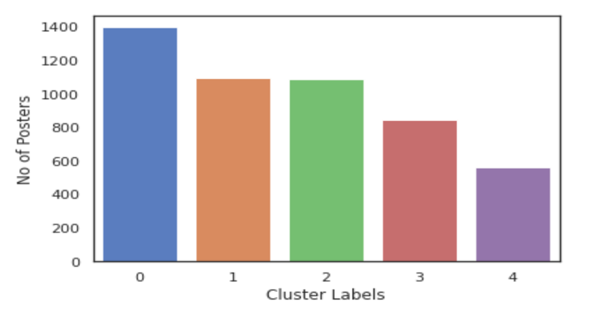
No of pamphlets to each cluster group
For cluster 0 around 1398 posters will be distributed for five different locations and similarly 1095, 1093, 844, 560 number of posters for cluster 1, 2, 3, 4

Slide 12
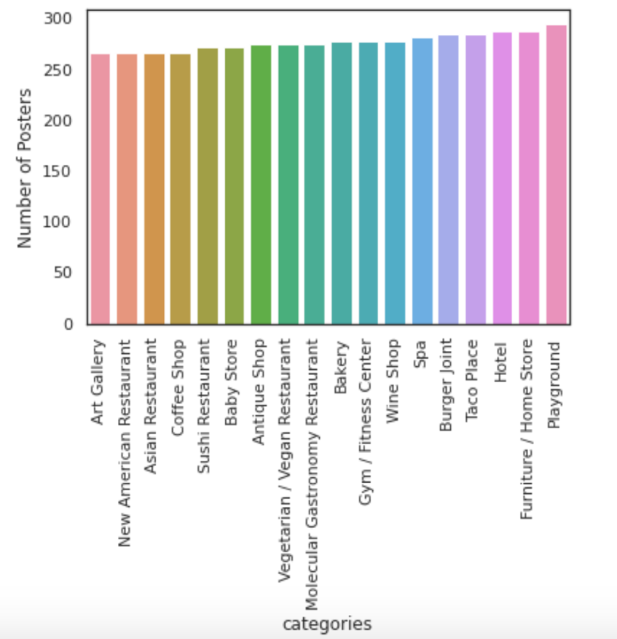
No of pamphlets distribution to each category
The playground category will be the location where most of th ephamplets will be distributed based on our KNN(k=5) clustering model

Slide 13
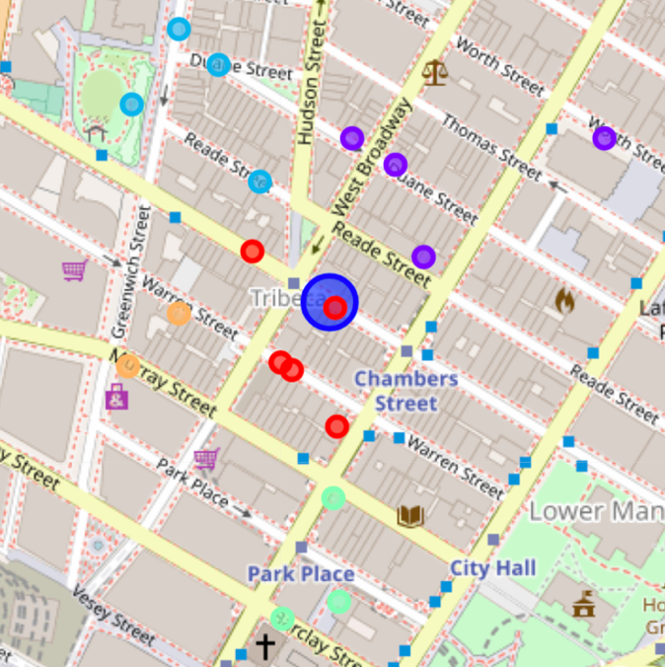
18 locations surrounding Eeco(Large Blue circle), are the most prominent locations where the Eeco management could focus on distributing their pamphlets to have a maximum reach to the general public

Slide 14
Conclusion & Future Directions
The approach mentioned in this study will help small scale business to identify the most prominent locations to market their products to have a better reach of audience and make sure their marketing strategies plays a vital role in their profit.
This kind of an approach will help the establishment an upper hand over their competitors in gaining more attraction and audience and help them in building a brand value.
The model helps us in identifying and filtering the possibilities to reduce extreme cost in marketing

Slide 15
Thank you!

